Slide 1
Risky Business:
Setting the stage with regional data
Megan Hoopes, MPH
mhoopes@npaihb.org
503-416-3261

Slide 2
Prevalence and incidence
Incidence = number of new cases in a population per year (rate, often “per 100,000”)
Prevalence = number of existing cases in a population at a given point in time (often “percent”)
Measured with incidence
  Deaths
  Cancer
  Injuries
  STDs
  Diabetes
  Measured with prevalence
  STDs
  Diabetes
  Smoking
Notes:
Incidence – usually age-adjusted
Notice that prevalence events are typically conditions that one lives with over time – things like injuries & mortality are really only measured in incidence b/c they happen at one point in time.

Slide 3
What’s the prevalence/ incidence of . . .?
All statistics are for the state of Washington
Notes:
Almost 14% of Native people in Washington have been diagnosed with diabetes – this is a prevalence figure.
(13,800 people out of 100,000)

Slide 4
What’s the prevalence/ incidence of . . .?
All statistics are for the state of Washington

Slide 5
What’s the prevalence/ incidence of . . .?
All statistics are for the state of Washington
Notes:
If you have a group of 100,000 people, about 570 of them will develop cancer in an average year.
Note scale (not a huge disparity even though it looks like it)

Slide 6
What’s the prevalence/ incidence of . . .?
All statistics are for the state of Washington

Slide 7
What’s the prevalence/ incidence of . . .?
All statistics are for the state of Washington
Notes:
Rate the same for all age groups, but we’ll look at this data in more detail later.

Slide 8
got risk?

Slide 9
Risk factors
A characteristic that increases a person’s chances of getting a disease (or health outcome)
An association, but not necessarily a cause
May be:
  Something you do – behavioral
    Smoking cigarettes is a well-established cause of lung cancer
  Just who you are – non-modifiable
    Being over 50 years old is a risk factor for colon cancer, but having a 50th birthday does not cause colon cancer
Notes:
Risk factor is more common among people w/ the condition (health event) than among people without the condition.
Behavioral – smoking or wearing a seat belt
Risk factors can also be environmental

Slide 10
Risk factors
Smoking
Physical activity
Alcohol & drug use
Genetics
Helmet use
Fruit & vegetable intake
Condom use
Obesity
Gender
Cancer screening
Seatbelt & child safety seat use
Health Outcomes
Diabetes
STDs
Unintentional injuries
Cardiovascular disease
Cancer
Suicide
Notes:
Which are modifiable, and which are not?
Behavioral risk factors are commonly associated with multiple negative health outcomes
Let’s talk about some of these risk factors that are associated with many of the leading diseases in our population.

Slide 11

The biggie . . . Tobacco
In Washington . . .
Smoking prevalence among Natives is 32%. This is significantly higher than the state rate of about 17.5%.
Native Americans in Washington have a higher incidence of lung and bronchus cancer than Washington State as a whole,
and have a higher rate of trachea, lung and bronchus cancer mortality.
Notes:
Diabetes, cardiovascular disease, cancer

Slide 12
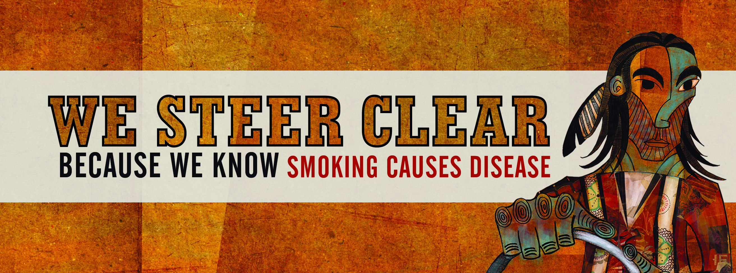

Bronchitis
Emphysema
Coronary Heart Disease
Cirrhosis of the liver
Low birth-weight babies
SIDS
Miscarriage
Cardiovascular disease
Pneumonia
Impotence and Infertility
Lip cancer
Tongue cancer
Gum cancer
Larynx cancer
Lung cancer
Peptic ulcer
Bladder cancer
Notes:
Smoking is a risk factor for almost EVERY chronic disease
Slide from Western Tobacco Prevention Project

Slide 13
Diet &
nutrition
2001 Northwest Tribal BRFSS: Percent of respondents who reported eating 5 or more servings of fruits and vegetables per day
Five to nine servings of fruits and vegetables per day are recommended to reduce the risk of heart disease, diabetes, and certain types of cancers.
^{--American Cancer Society}
6.1%
Data source: NPAIHB, NW Tribal BRFSS Project, Aggregate Final Report
Notes:
Diet & nutrition
Compared to 14.8% of Washington’s population as a whole

Slide 14
Obesity & physical activity
In postmenopausal women, obesity increases the risk of breast cancer by about 50%. Obese women are also more likely to have breast cancer diagnosed at later stages and to die from breast cancer than non-obese women.¹
35.3% of NW Tribal respondents report an activity level meeting recommendations²
79% of NW Tribal women are over ideal weight²
The CDC and the American College of Sports Medicine recommend that adults accumulate at least 30 minutes of moderate physical activity on at least five days per week or at least 20 minutes of vigorous activity on at least three days per week.³
¹National Cancer Institute, www.cancer.gov/cancertopics/factsheet/risk/obesity
²Data source: NPAIHB, 2001 NW Tribal BRFSS Project, Aggregate Final Report
³The Centers for Disease Control and Prevention, www.cdc.gov/nccdphp/sgr/contents.htm
Notes:
79.0% of women respondents to the 2001 NW Tribal BRFS reported being over their ideal weight, by BMI
OR – 44.5%, WA – 41.7%
No comparable physical activity question asked in all-race state BRFSS surveys

Slide 15
Cancer screening
2008 Portland Area GPRA, IHS
For certain cancers, lack of appropriate screening is a big risk factor
  Breast & cervical screening can detect pre-cancerous and cancerous conditions early
  Colorectal screening can both detect cancer early and prevent cancer by removal of polyps (colonoscopy)
2010 IHS goal: 90%
2010 IHS goal: 70%
2010 IHS goal: 50%
Notes:
For certain cancers, lack of appropriate screening is a big risk factor. Screening for breast and cervical cancer can detect pre-cancerous and cancerous conditions EARLY, at a stage where the chances of successful treatment are very high. In the case of colorectal cancer, colonoscopies can actually PREVENT cancer by allowing the opportunity to remove pre-cancerous polyps. The flip side is that LACK of appropriate cancer screening can be a risk factor for cancer death, and in the case of colorectal cancer – a risk factor for cancer itself.
Pap – women ages 21-64
Mamm – women 52-64
CRC – 51-80

Slide 16
Cancer Among AI/AN
Second leading cause of death for American Indians in Washington
Leading cause of death for Alaska Natives
Patterns for cancer types vary
Notes:
Here is a little overview information for the health topics we’ll be discussing today.

Slide 17
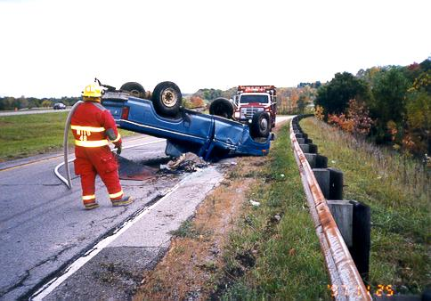
Unintentional Injury
Motor vehicle crashes are the leading cause of death for AI/AN people ages 1-44¹
Native American children die from injuries twice as often as children from other races²
In the Northwest, falls are responsible for up to 25% of unintentional injury deaths for American Indians/Alaska Natives aged 55 and over¹
¹CDC, National Center for Injury Prevention and Control. Web-based Injury Statistics Query and Reporting System (WISQARS): www.cdc.gov/ncipc/wisqars
² CDC, National Center for Health Statistics. National Vital Statistics System. 2000-2004 mortality statistics.
Notes:
Fewer parents in tribal communities use child restraints than parents in other places. This means American Indian children are getting hurt more often than they need to in motor vehicle crashes.
Easily modifiable risk factor - Helmets can reduce head injuries by 85% and brain injuries by 88% ²

Slide 18
Motor Vehicle Death Rates by Race, 2005
N=295,895,897
Source: Centers for Disease Control and Prevention, National Center for Injury Prevention and Control. Web-based Injury Statistics Query and Reporting System (WISQARS) [online]. (2005) [cited Feb 17 2009]. Available from URL: www.cdc.gov/ncipc/wisqars
Notes:
American Indians die in motor vehicle crashes at a higher rate than any other racial group

Slide 19
Suicide
Notes:
Suicide is another cause of premature death that disproportionately affects our population, and is more common among young people. As I showed toward the beginning, for all ages grouped together, the rate of suicide in Washington is the same for AI/AN as for all other races combined, but when you look at younger age groups, the rate is much higher for AI/AN than for all other races combined.

Slide 20
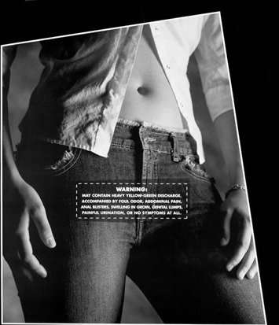
1 out of 4 sexually active teens will get a STD this year.
Notes:
STD data for AI/AN are a bit harder to come by, because race and ethnicity are less frequently collected by the data systems that monitor STDs around the country. However, we do know that the rates of some STDs for AI/AN are higher than their counterparts of other races.

Slide 21
Compared by race/ethnicity, American Indians and Alaska Natives ranked 3rd in their rate of HIV/AIDS diagnoses in 2005

Slide 22
 | Leading causes of death by age group American Indian/Alaska Native, Washington, 2003-2007 Data source: WA Dept. of Health, Community Health Assessment Tool (CHAT), accessed 2/10
 | Age group
Rank | <1 | 1-4 | 5-14 | 15-24 | 25-34 | 35-44 | 45-54 | 55-64 | 65+
1 | SIDS (15) | Unintentional injury (9) | Unintentional injury (5) | Unintentional injury (100) | Unintentional injury (78) | Unintentional injury (72) | Cardiovascular diseases (94) | Cardiovascular diseases (143) | Cardio -vascular diseases (476)
2 | Congenital anomalies (14) | Homicide | Cancer | Suicide (25) | Suicide (20) | Cardiovascular diseases (36) | Unintentional injury (79) | Cancer (124) | Cancer (335)
3 | Short gestation, low birthweight (9) | T - Cancer | Suicide | Homicide (14) | Cardiovascular diseases (12) | Liver disease & cirrhosis (33) | Liver disease & cirrhosis (53) | Diabetes (45) | Chronic lower respiratory diseases (101)
4 | Unintentional injury (7) | T –Cardiovascular diseases | Cardiovascular diseases | Cardiovascular diseases (5) | Homicide (10) | Suicide (21) | Diabetes (12) | Liver disease & cirrhosis (41) | Diabetes (92)
5 | T -Cardiovascular diseases |  |  | T - Cancer | Cancer (6) | Cancer (18) | Homicide (9) | T - Influenza & pneumonia (5) | Alzheimer’s disease (61)
6 | T - Influenza & pneumonia |  |  | T - Congenital anomalies | Liver disease & cirrhosis | Homicide (8) | Chronic lower respiratory diseases (8) | T - Suicide (5) | Uninten- tional injury (43)
7 | Homicide |  |  | Pregnancy & childbirth | Influenza & pneumonia | Diabetes (6) | Suicide (7) | T - Pneumonitis due to solids and liquids (5) | Influenza & pneumonia (30)
(n) = number of deaths; if no number specified, the number of cases is too small to report T = one or more causes tied for position
Notes:
Look at all these largely preventable causes of death. It does indeed paint a grim picture, but the good news is – most of these are indeed preventable.

Slide 23
Hooray for data!
Data informs our prevention/intervention efforts
  Because we understand:
    Which risk factors are associated with which health outcomes
    The prevalence of modifiable risk factors in our communities (“high risk” groups)
    The incidence/prevalence of health events in our communities
  Data guides the focus of our policy and programs
  Data measures the success of interventions
Data is a powerful tool to share with policymakers, community advocates, and funders
Notes:
Survey and surveillance data gives us an excellent picture a population’s health and can be used to guide prevention and intervention efforts on the community level. It can also be a powerful tool to share with policymakers (tribal council), community advocates, and to leverage additional funding. For that reason, I tried to include data sources and citations throughout this presentation – so feel free to use these numbers in your advocacy and education efforts.
Primary prevention – prevention or exposure to a risk factor
Secondary prevention – early diagnosis (cancer & diabetes screening) to reduce risk of negative outcomes

Slide 24
Data is not perfect
Surveillance data is collected at the state or national level
  May not apply to every tribe or community
American Indians and Alaska Natives are not always classified correctly
  Racial misclassification under-reports the impact of health events for AI/AN
You are the experts!
Notes:
Doesn’t tell the whole story
Not always representative – for example, we know that cancer rates and trends for American Indians and Alaska Native vary considerably in different parts of the country. And when we’re measuring cancer incidence or mortality, the numbers are pretty small, so we usually combine larger regions or longer periods of time to calculate those numbers. That means that regional variations are hidden in the numbers.
A limitation of such data is that it may not apply to every community – most of these numbers were collected from national samples and may not be representative of all tribes and Native communities. That’s where your experience and expertise working on the ‘ground level’ come in.
Your experiences working on the ground level give you an insight into your communities and their health needs that no state data registry or federal statistician can rival.

